Slide 1
Digital Watermarking and Steganography - Mini Project SoSe 2019
Group 11: Sarah Böning, Anh Phoung Lee, Kai Gerrit Lünsdorf

Slide 2
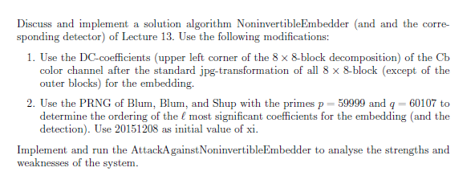
The Exercise

Slide 3
Our Interpretation
Implement 3 algorithms: Embedder, Attacker, Detector
Embedder: follow the given algorithm, but embed watermark on a random path (generated by BBS) of the upper left corner DCT coefficients of the Cb-colour channel
Detector: Takes watermarked & original image and computes the similarity
Attacker: tries to embed his own watermark
Analysis of the Watermarking System
Rightful Ownership Problem (Multiple public watermarked images)
others???
Python 3.7

Slide 4
Implementation - Embedder
Pseudocode of our own implementation
Some explanations maybe

Slide 5
Implementation - Detector

Slide 6
Implementation - Attacker

Slide 7
Analysis
What do we want to find out
Maybe some expectations

Slide 8
Analysis - Procedure
Take X photos with different features
Run the algorithms for each photo
‚do the math‘
Plot the results
Find a conclusion

Slide 9
Analysis - The Photo Set
All photos we used for the analysis as a collage here

Slide 10
Analysis - Results
What we found plus all the graphs

Slide 11
Conclusion
Is it safe against the Rightful Ownership Problem & the Attacker with multiple public images?
Is is safe in general/ against other attacks?
Strenghts and weaknesses of our wm system
How good are our results/limitations
Etc.

Slide 12
Any questions?
Thank you for your attention.

Slide 13
References
Lecture notes „Digital Watermarking and Steganography SoSe 2019“, Andreas Jakoby, Bauhaus University Weimar
Craver, Scott & Memon, Nasir & Yeo, Boon-Lock & Yeung, Minerva. (1997). On The Invertibility Of Invisible Watermarking Techniques. 1. 540 - 543 vol.1. 10.1109/ICIP.1997.647969.
Python 3.7
Numpy 1.16

